Slide 1

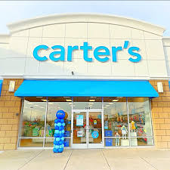

Carter’s
Growing Up
Joy Navarro, Ben Schott, and Erica Bennett

Slide 2





Carter’s Inc. currently owns 3 retail companies, Carter’s, Osh Kosh B’gosh, Little Planet and Skip Hop.
Carter’s is a childrens clothing company for children from newborn to tweens.
Carter’s competition is The Children's Place, Baby Gap/ Gap Kids, and Crew Cuts by J Crew
Carter’s currently has wholesale partnerships with Walmart, Meijer, Khol’s, Sam’s Club, and Target
Executive Summary: Current Carter’s Inc Portfolio
Notes:
The Children’s Place cohesive brand image
Cat & Jack playful styles that follow the latest trends
babyGap / GapKids styles are more contemporary and minimalistic
CrewCuts by J Crew already implementing age-up strategy
Existing wholesale partnerships notes:
These partners all have their own private label kids collections in addition to selling carters merchandise.

Slide 3


Executive Summary
These are the following observations made from visiting Carters:
  Clothing Quality is top tier and the brand even features in some of their store fronts their organic clothing line called Little Planet
  The customers are mostly mothers and we noticed they were often shopping with their children
  The most popular product was the new board - 4-year-old clothing section. We felt there was a gap in the audience for kids between the ages of 7-14 which is the in-between stages of childhood and teenage years
Who is Carter’s Competition?
  The Children’s Place cohesive brand image
  Cat & Jack playful styles that follow the latest trends
  babyGap / GapKids styles are more contemporary and minimalistic
  CrewCuts by J Crew already implementing age-up strategy
Existing Wholesale Partnerships
  Walmart
  Meijer
  Khols
  Sam’s Club
  Target
These partners all have their own private label kids collections in addition to selling carters merchandise.

Slide 4
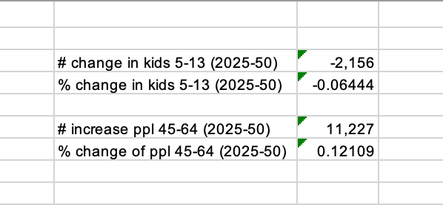
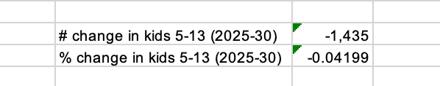
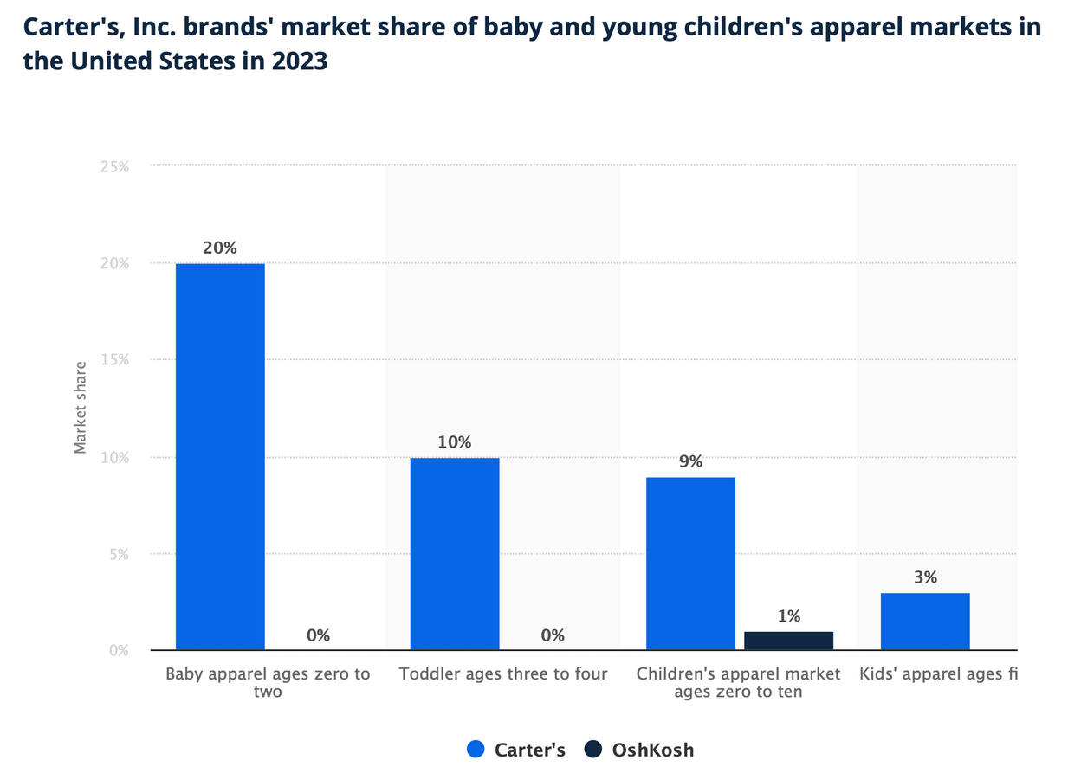
What Share of the Childrenswear Market does Carter’s Hold?
Analysis of US Census Bureau Data:
Based on the 2023 National Population Projection Data:
  There will be a decrease in the # of kids ages 5-13 betweeen 2025-30 & 2025-50
According to Carter’s 2022 Annual Report:
  The apparel market for newborn to 10-year-old children in the United States is over $29 billion
  Over 30% of the market is brands with less than 1% share
  Carter’s share of the market is 70% larger than their nearest competitor.

Slide 5

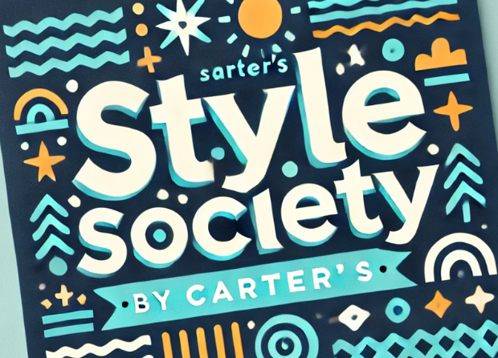
INTRODUCING STYLE SOCIETY
Style Society is a brand in connection to Carter’s that caters to children ages 7-14.
This brand intends to bridge the gap between children’s clothing and teenage clothing, creating stylish yet appropriate clothing for older children and pre-teens.
(logo example made with AI)

Slide 6



Style Society : Brand Overview
As kids age and discover more about themselves, they will likely to want to express their own unique interests. To best cater to this natural change in expression, we want to include a section of accessories on a tiered carosel.
In this section, kids age 7-14 can feel like they have their own purchasing power, increasing their desire for products. Converting a corner of select Carter’s stores into a Style Society Section would help young shoppers embrace their growing desire for autonomy. The clothes in this section would feature fashion-forward styles comprised of sustainable fibers and made using environmentally-conscious production methods.
This collection will also be available in its own Carter app section. Kids would not have the ability to purchase, yet they can make lists of products they want. These lists can be shared with family and parental guardians so that they can gain a better idea of the styles that interest their child.
Notes:
Growing up often brings a desire for individuality. We plan to create a section for kids to shop independently, showcasing Little Planet merchandise in a unique way, with space for accessories.

Slide 7
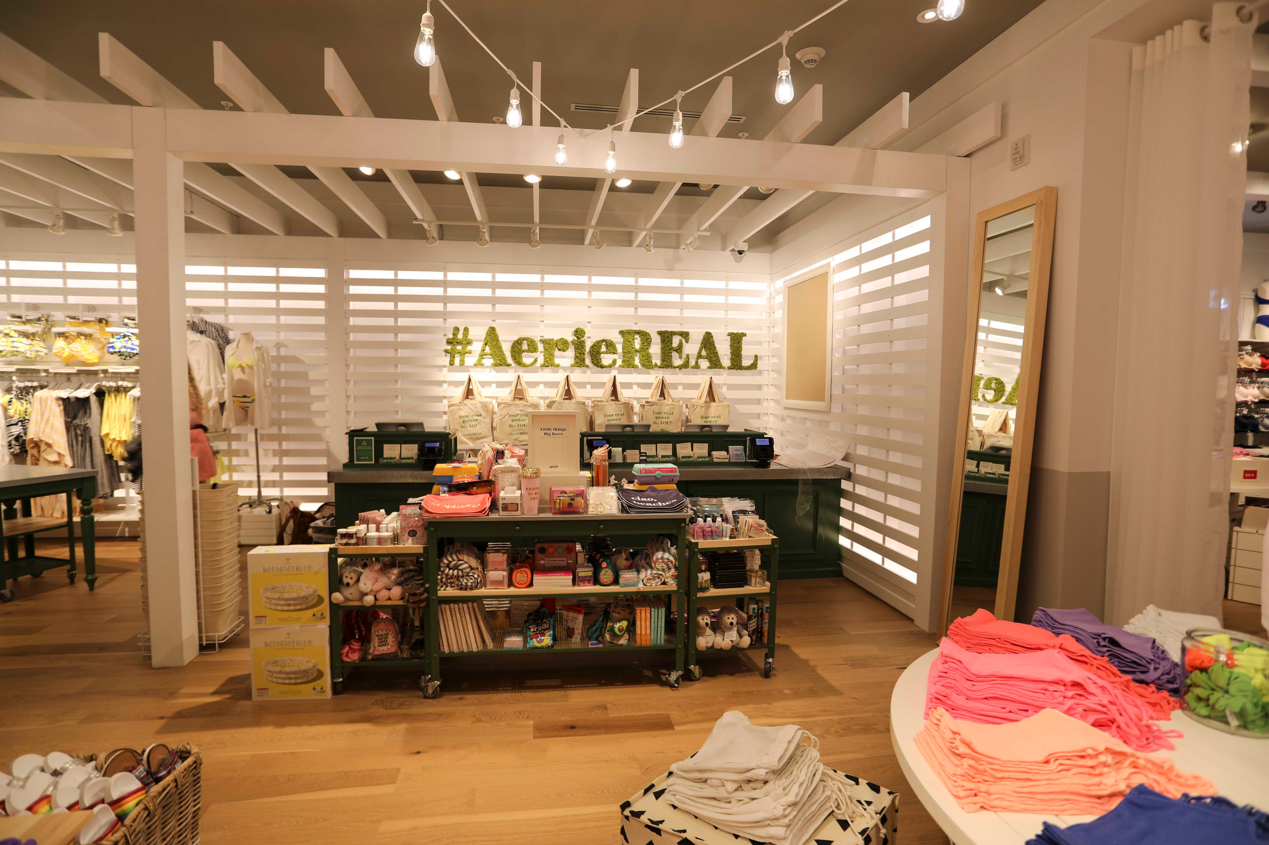
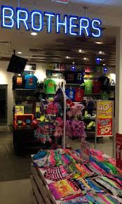
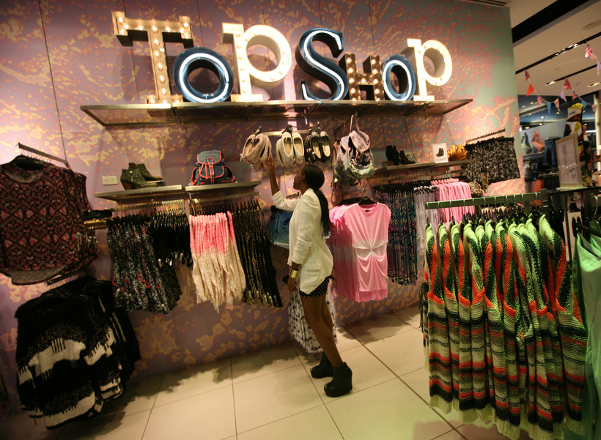

Style Society in-store inspiration
We are taking inspiration from these 3 stores. We want to open a Style Society section inside of Carter’s containing a specialized collection for pre-teens.
TopShop inside of Nordstrom
Aerie from AE
Brothers inside of Justice
{We are only taking inspiration of the set up from these stores, the only audience inspiration shared with these stores would be Brother’s (and their main store Justice).}

Slide 8
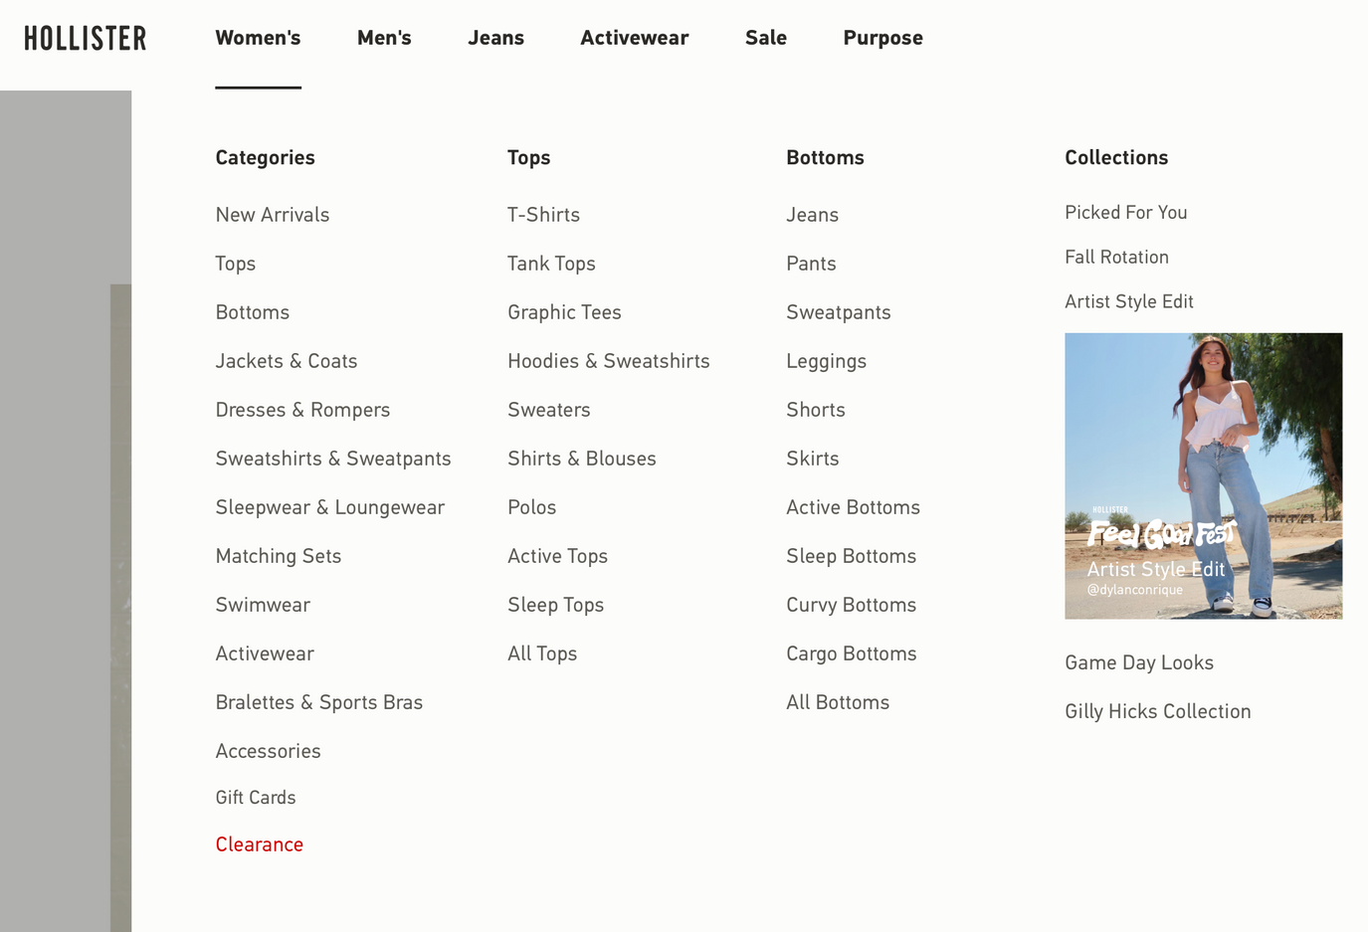
“Style Society” Online Inspiration
A section comparable to the Gilly Hicks section on the Hollister website would be available on the Carter’s website to make access to the Style Society collection more accessible.
NOTE: APP AS WELL, WANT LIST FOR KIDS

Slide 9
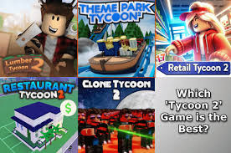
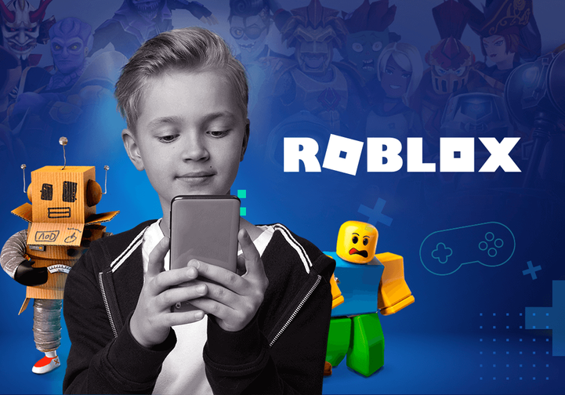
Style Society PR Plan
Over half of the kids today in America are playing Roblox!
Roblox has a type of game called Tycoons where you can customize your virtual world of different realities such as restaurants, theme parks, resorts, and now style society. Kids are obsessed with these Tycoon worlds because you can be a part of these worlds in any way.
In Style Society, kids can choose to be employed and help others make outfits or they can shop virtually in the Style Society section! Having kids interact virtually with their friends will make them more excited to come shop in person and also feel contected to store.

Slide 10
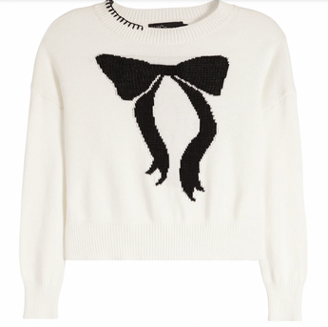
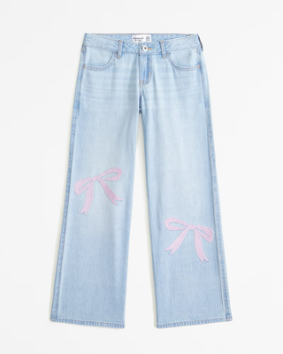
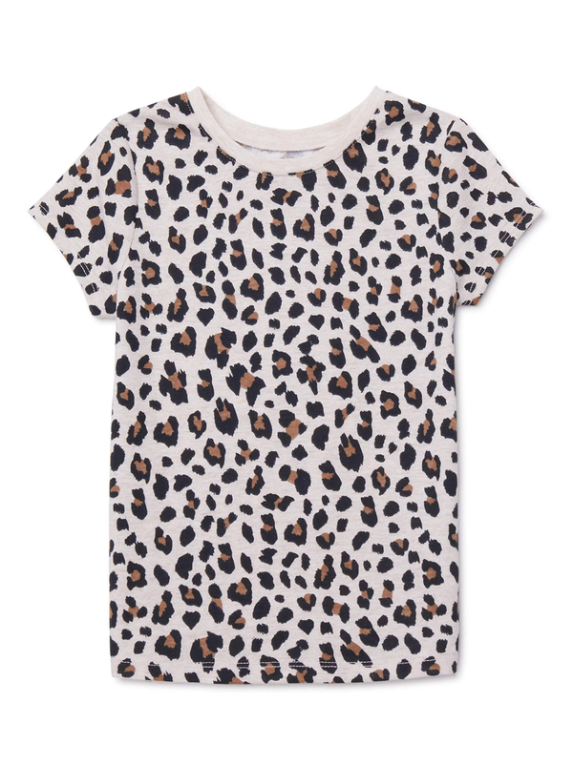
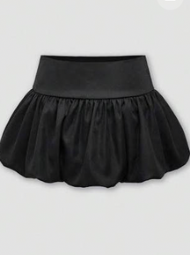
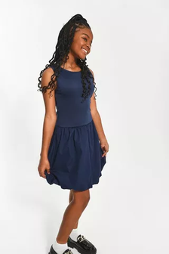
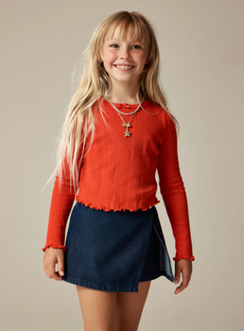
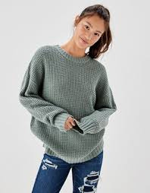
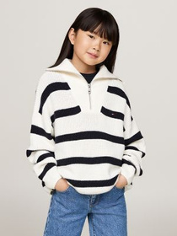
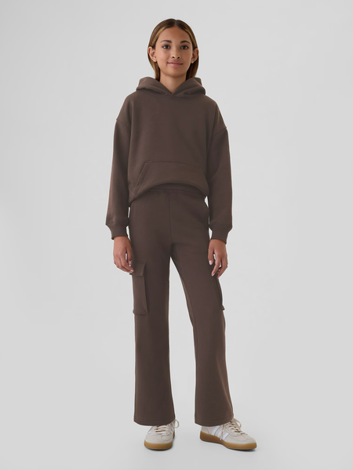
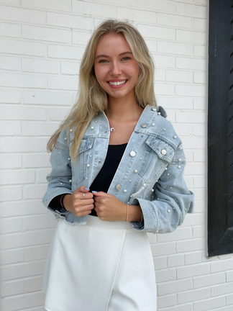
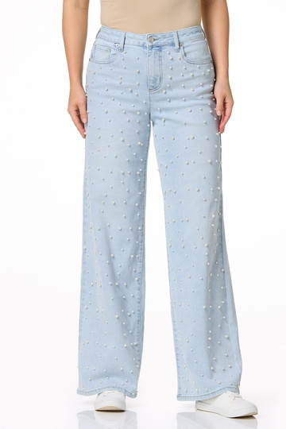
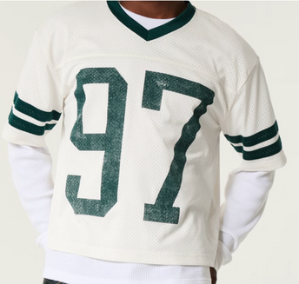
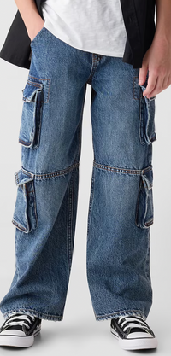
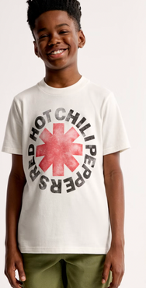
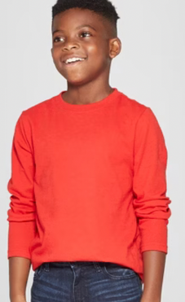
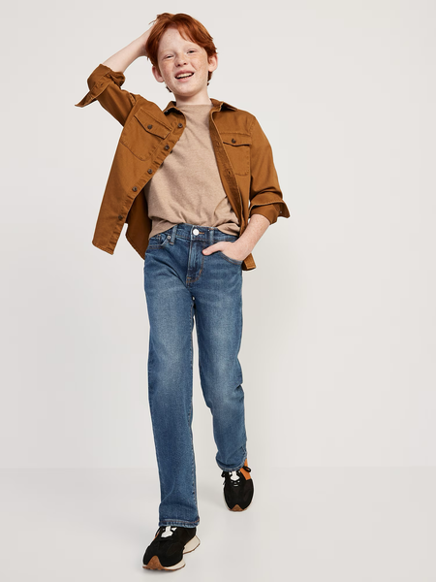
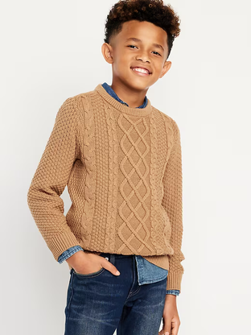
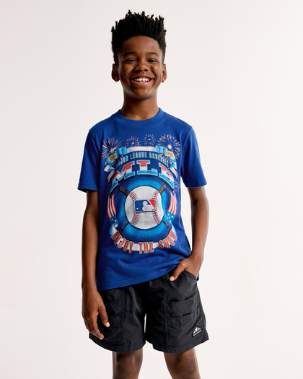
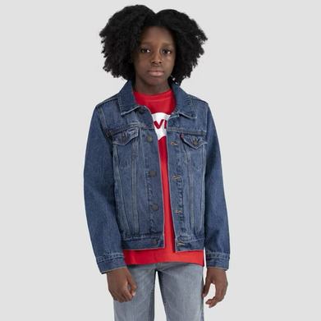
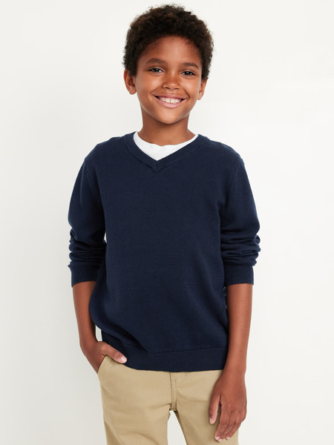
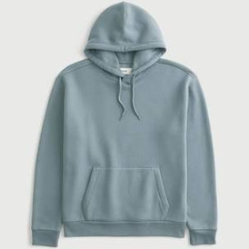
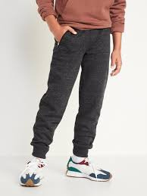
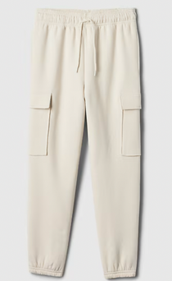
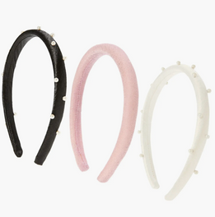
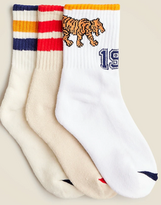
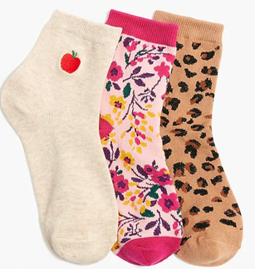
Style Society Assortment Plan
Styles of Clothing we will offer (inspiration photos from other brands) :
Bow sweater from
Chic to Chic
Bow Jeans from
Abercrombie
Printed tee from
Garanimals
Bubble Skirt
from Shein
Bubble Dress
from Mr. Price
Long Sleeve
from Crew Cuts
Waffle Knit
Sweater from
AE
Quarter Zip from
Tommy Hilfiger
Cargo Sweatpants
from The Gap
Embelished Jean
Jacket
from Gibson Girls
Embelished Jeans
from Cato
GIRLS
BOYS
Boy’s Jersey
Style Tee
from Hollister
Boy’s Cargo
Pants from
The Gap
Boy’s Printed
Tee from
Abercrombie
Boy’s Long
Sleeve Tee from
Cat and Jack
Boy’s Straight
Leg Jean
From Old Navy
Boy’s Cable
Knit Sweater
From Old Navy
Boy’s Graphic
Tee from
Abercrombie
Boy’s Denim
Jacket from
Levi’s
Boy’s V-Neck
Sweater from
Old Navy
Boy’s Hooded
Sweatshirt from
Hollister
Boy’s Jogger
Sweatpants from
Old Navy
Boy’s Cargo
Sweatpants
from The Gap
ACCESSORIES
Girl’s Headband
3 Pack
from Nordstrom
Boy’s Sock
3 Pack
from JCrew
Girl’s Sock
3 Pack
from JCrew

Slide 11
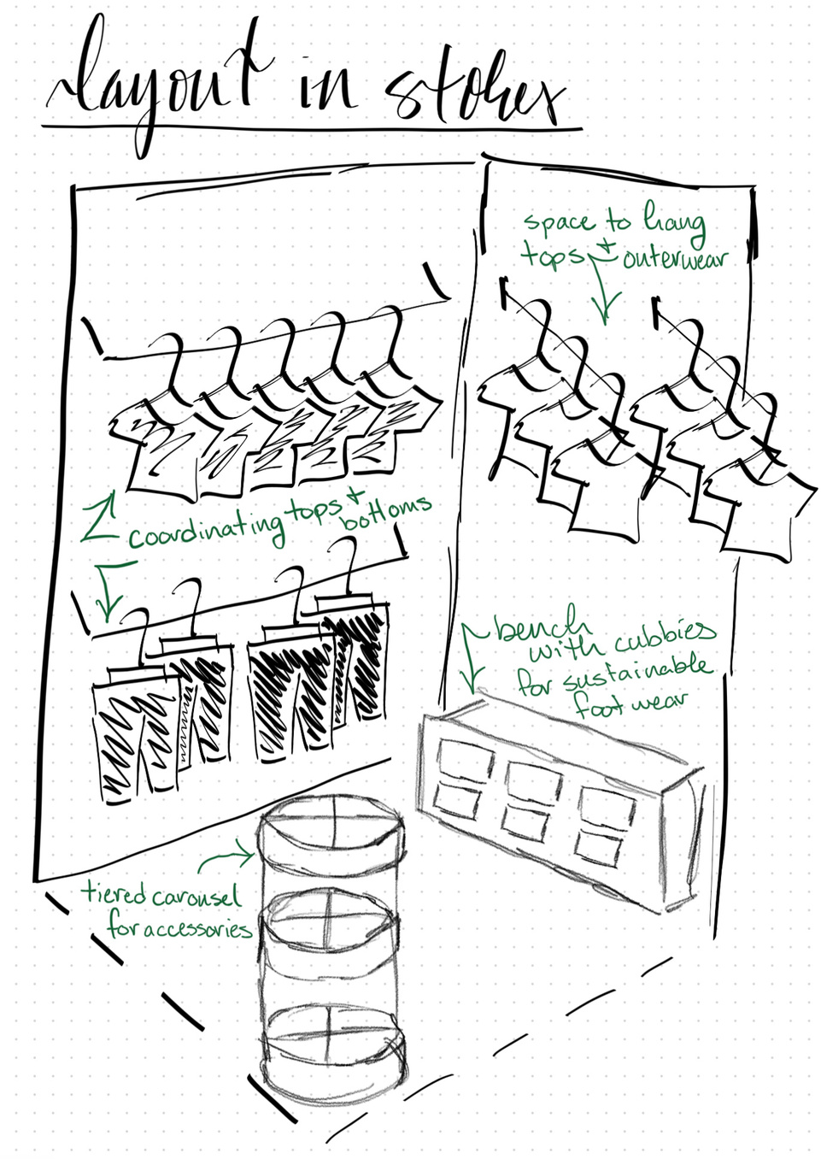
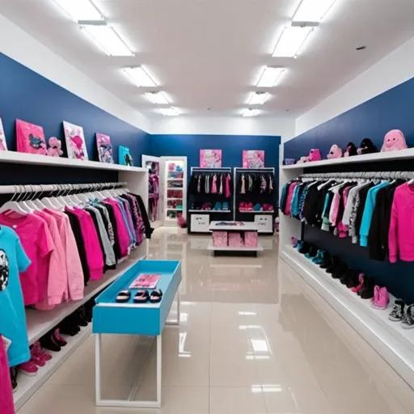
Floor Plan:

Slide 12
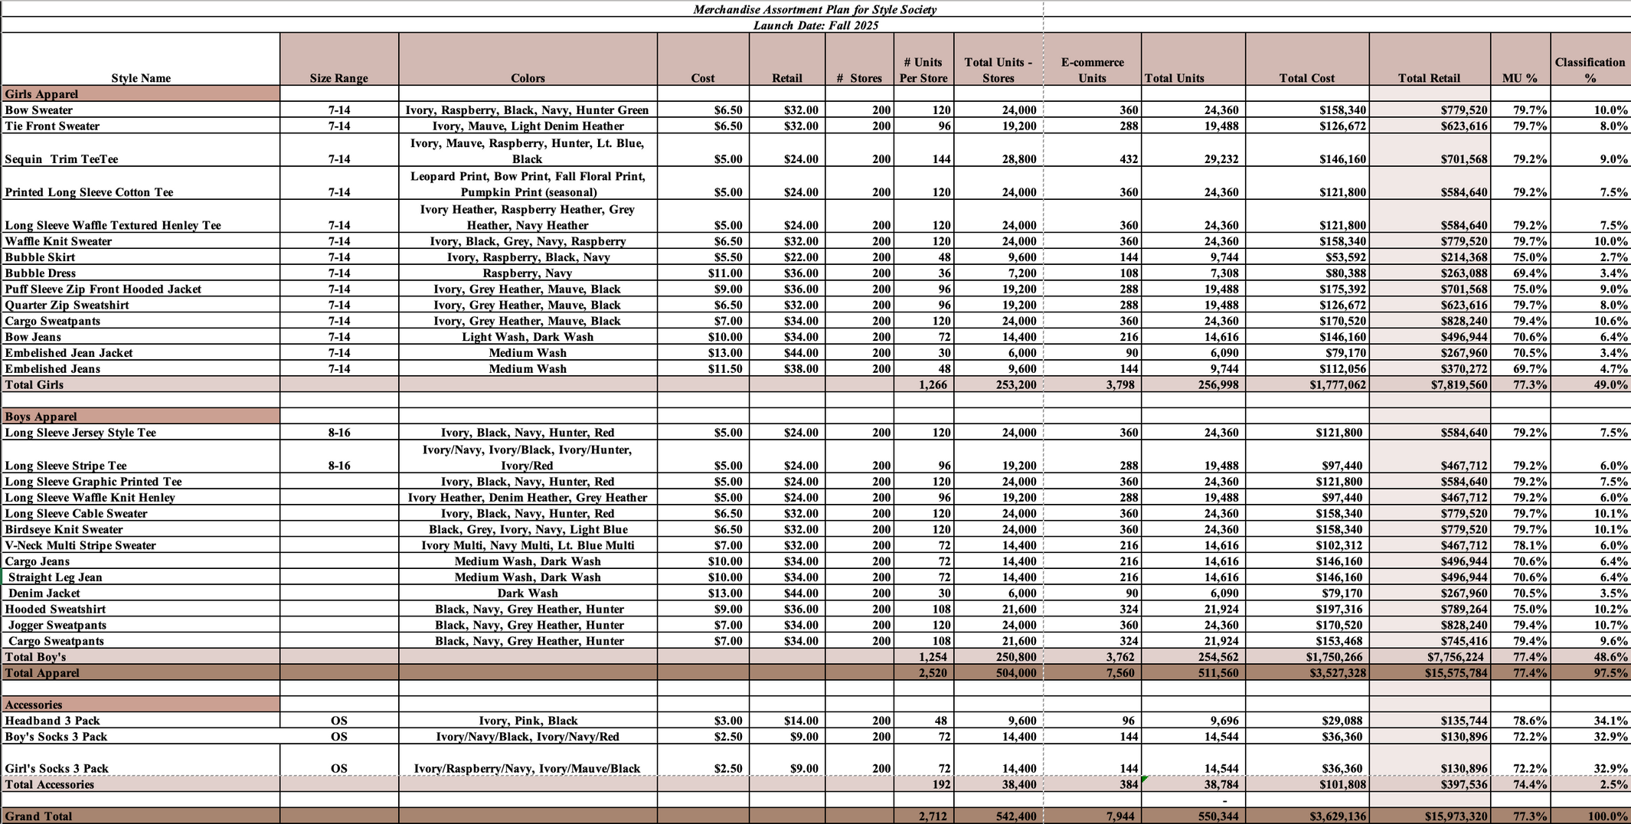
Merchandise Assorment Plan :

Slide 13
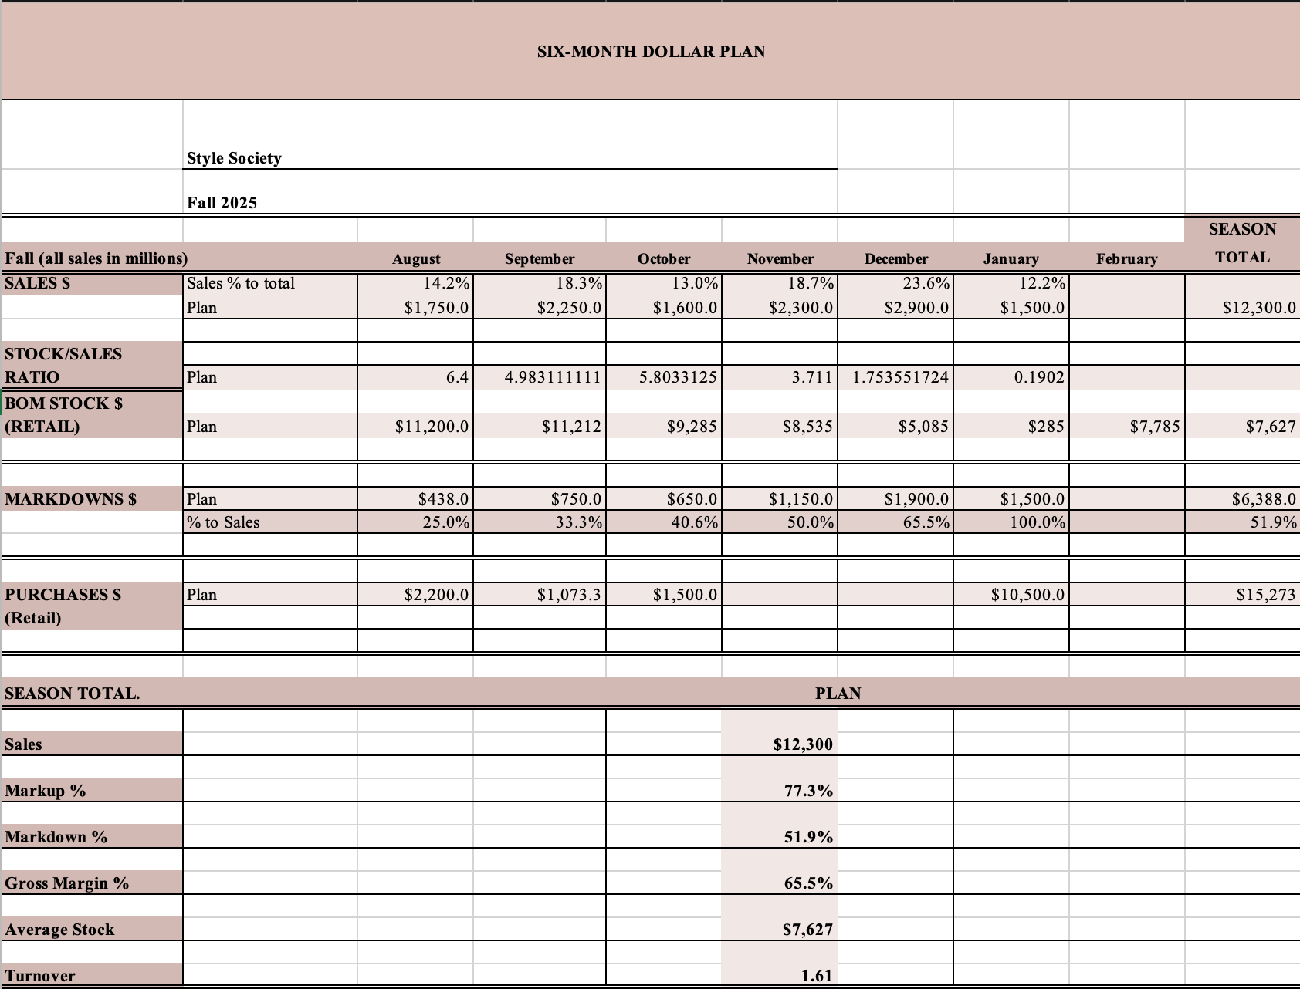
6 Month
Sales Plan :

Slide 14
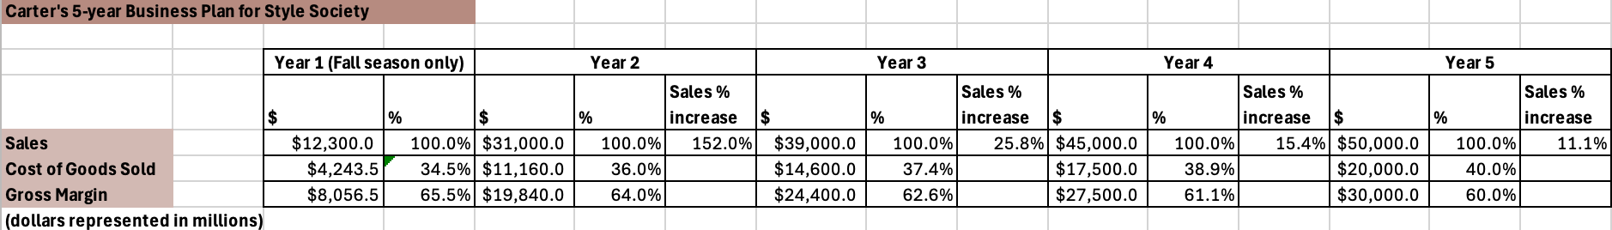
5 Year Business Plan :

Slide 15
Influencer Collaborations: Partnering with micro- and macro-influencers to promote the brand.
Micro-influencers and Macro-Influencers: $500–$5,000 per post
Total Budget: $50,000
--------------------------------------------------------------------------
Paid Social Media Ads: Facebook, Instagram, TikTok, YouTube, etc.
Total Budget: $20,000
---------------------------------------------------------------------------
Content Creation (Photography, videography, editing, copywriting)
Monthly: $5,000
Total Budget: $60,000
---------------------------------------------------------------------------
Signage (Indoor/Outdoor): Retail store signs, banners, mall ads.
Initial Design and Installation: $5,000
Total Budget: $5,000
---------------------------------------------------------------------------
Brand Launch Events: Grand opening events, giveaways: $5,000 per event
Number of events: 3-5 major cities
Total Budget: $25,000
---------------------------------------------------------------------------
PR Firm: brand reputation, media, press releases.
Monthly: $5,000 - $10,000
Total Budget: $80,000
---------------------------------------------------------------------------
Press Events: Launch coverage, influencer events
Total Budget: $30,000
---------------------------------------------------------------------------
Website Development & Maintenance: User experience design, etc.
Total Budget: $30,000
---------------------------------------------------------------------------
Total Estimated Marketing Budget:
$300,000-$350,000
Style Society Marketing Budget
*Marketing Budget for Initial launch*
September 2025

Slide 16

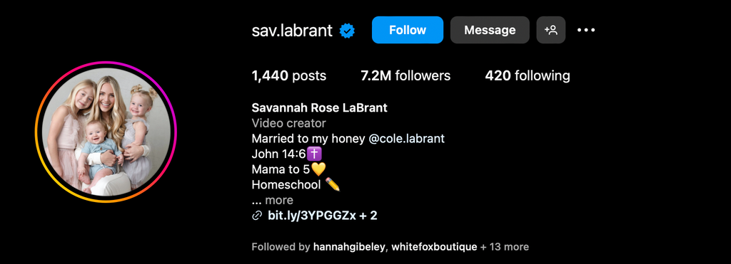
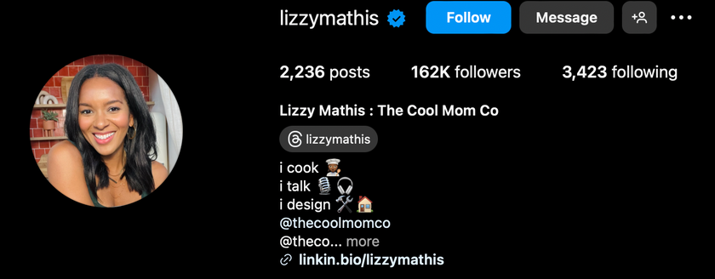



STYLE SOCIETY MARKETING PLAN
Our marketing initiative will consist mainly of working with Mommy Influencers to gain reach to the parent community on our Style Society launch.
Some of the influencers we would like to work with are:

Slide 17
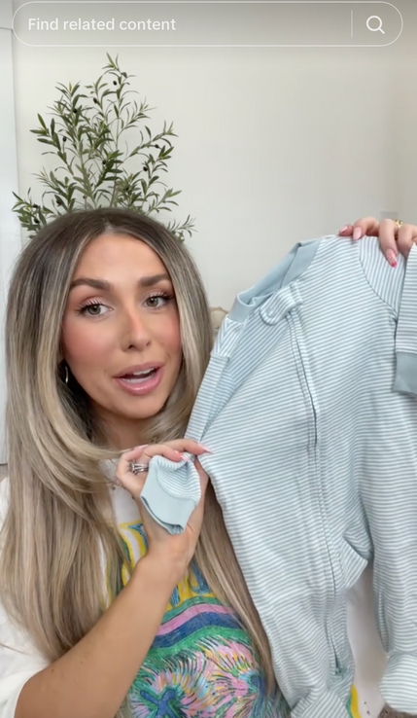
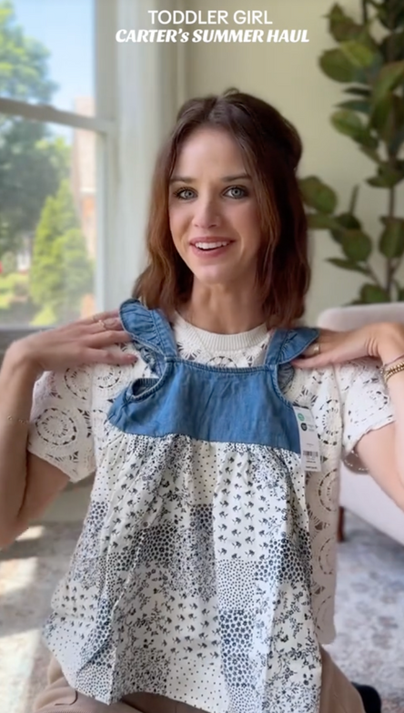
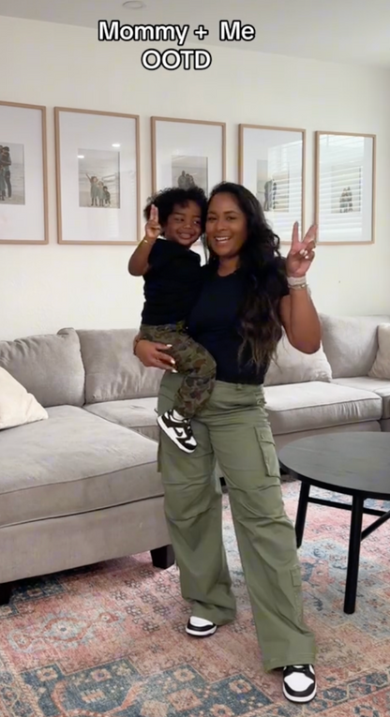
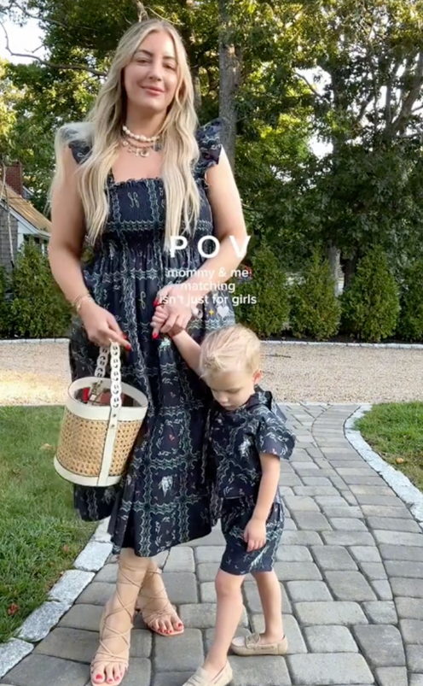
STYLE SOCIETY x MOM INFLUENCER EXAMPLE CONTENT

Slide 18
STYLE SOCIETY REWARDS PLAN
In addition to marketing the launch of Style Society in collaboration with mommy influencers, Carter’s and Style Society will launch their updated sustainability rewards program.
For each piece of clothing brought in, rewards members can gain 5-10 points depending on the condition and the type of clothing piece (for ex. cotton t-shirts -> 3 points, denim pants -> 5 points).
Style Sustainably Rewards is a rewards program where parents can bring in their childrens clothes from Carter’s to Style Society when their child becomes to big for their Carter’s clothes. The donated clothes will be used for Little Planet.
When customers reach 50 points, they can get 20% off their total on their next purchase, when they reach 100 points, members can get 25% off their total.

Slide 19
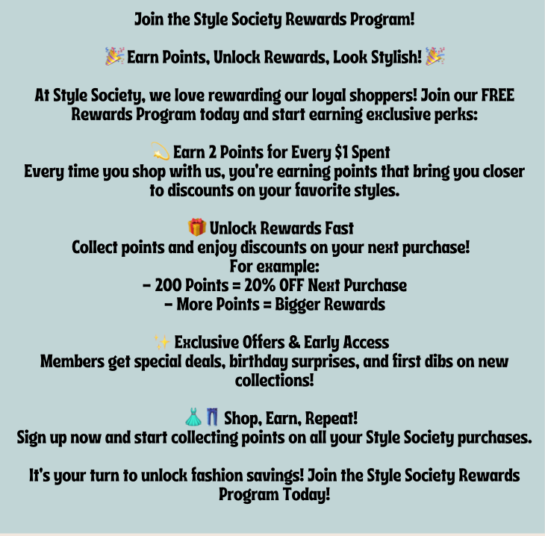
Style Society Rewards
This rewards program would be on top of the normal rewards program that Carter’s currently has.
We would also further enhance their current rewards program (1 point per every $1 spent with Family status, 2 points per every $1 spent with VIP status)
As customers receive points they will receive rewards in the form of discounts, for eg) 200 points unlocks 20% off their next purchase.
This will entice parents to spend more, so they can save more, and rack up more points.

Slide 20
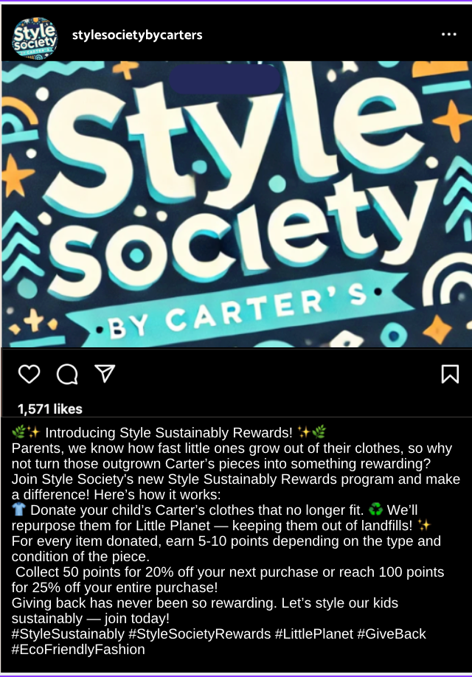

Style Sustainably Rewards
Social Media Marketing Examples

Slide 21
sources
https://www.nytimes.com/2022/11/22/opinion/influencers-moms-parenting.html
https://nypost.com/shopping/best-kids-clothing-brands-online
https://www.vogue.com/article/best-kids-clothing-stores-online
https://ir.carters.com/static-files/2e3783ec-523e-45f4-9d49-1e2c9669446d
https://www.statista.com/statistics/963254/carters-inc-brands-market-share-of-baby-and-young-children-s-apparel-markets-us/
https://www.census.gov/programs-surveys/popproj.html

